Slide 1
System Optimization Agent Procedures using Kaseya
Developed By: Jason Aparcana
Advisor : Dr. S. Masoud Sadjadi
School of Computing and Information Sciences
Florida International University
Your Email@fiu.edu
http://www.cs.fiu.edu/~sadjadi/

Slide 2
Agenda
Problem and Motivation
Solution
Behind the Scene
Customizing the Solution
Disclaimer
Progress Report

Slide 3
Problem and Motivation:
Users from the SCIS Workstation have reported system running very slowly, error messages, and Windows crashes. No prevention has being done in the past to prevent these system’s failures.
Constant system optimization is required in order to ensure that computer systems are always working in the fastest most efficient way possible.
An efficient system will allow users (students and/or workers) to operate in a reliable environment, producing more in less time.

Slide 4

Fig 1.1

Slide 5
Solution
Using Kaseya, I am going to create three Agent Procedures that will optimize system’s performance. These agent procedures will be store in a ‘System Optimization’ folder.
    Agent Procedure to convert C: to NTFS
    Check Disk Agent Procedure
    Windows Disk Cleanup Agent Procedure

Slide 6
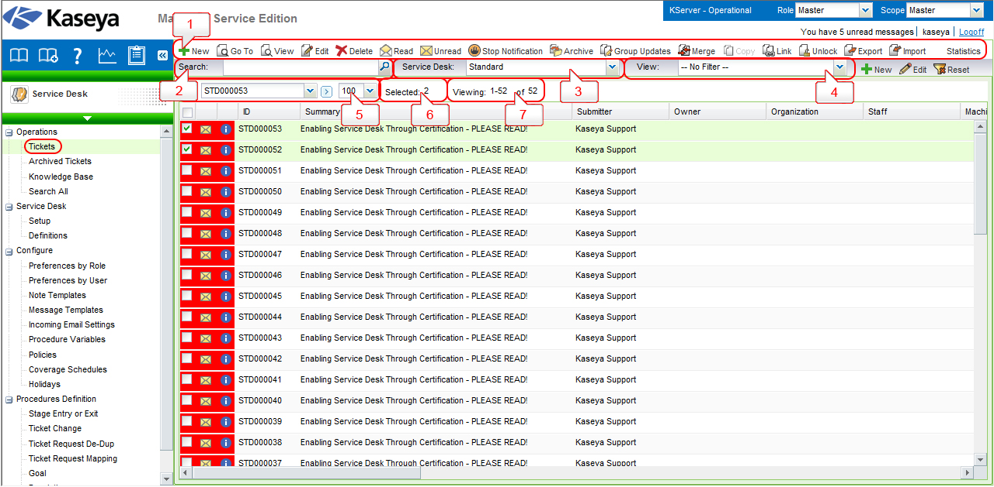
Fig 2.1

Slide 7
Behind the Scene
Convert C: to NTFS - Convert the file system format on the system drive (i.e. the boot partition) to NTFS from FAT/FAT32.
Check Disk command - Execute the Check Disk command to find and fix errors within the hard drive.
Windows Disk Cleanup (WDC) - This runs the native application in windows to clean temp files, IE cache files, check disk files, etc. This script runs 2 scripts. The First is a Registry setting script making sure all the settings are ready. The second runs the program with the registry settings.

Slide 8
Fig 3.1

Slide 9
Customizing the Solution
MAC
  Check Disk Procedure
  Use the “/sbin/fsck -fy” command to find and fix errors on a MAC OS.
  Disk Cleanup Procedure
  AppleJack for Mac is great alternative to cleanup your disk on a MAC computer.
Linux
  Check Disk Procedure
    Use the “fsck -t ext2 /dev/hda2” command to find and fix errors on a machine with Linux.
  Disk Cleanup Procedure
    Linux systems normally cleans itself up, so a manual disk cleaning tool isn't necessary. But if a cleanup is required, Fslint for Linux is a good tool option.

Slide 10
Fig 4.1

Slide 11
Disclaimer
C: to NTFS agent procedure, will only works on those operating systems which support NTFS (Windows NT4 / 2000 / XP / 2003 / Vista).
Disk Cleanup agent procedure, you may use any preferred cleanup tool compatible with windows, mac, or linux.

Slide 12
Progress Report
I have already finish with the agent procedures creation step by step.
I am missing the video tutorial and the screenshots
etc.

